Slide 1
Matrimonial Website
Name – Raghav Gupta

Slide 2
Matrimonial Website Project - Objective
User can enter his/ her biodata.
User can search for profiles according to his choice.
This is totally a front end project based on react.

Slide 3
Matrimonial Website Project - Frontend
The front-end part is made using react.
In react we have different components like home, navbar, footer, log in, etc.
All components are interconnected with each other using react routing.

Slide 4
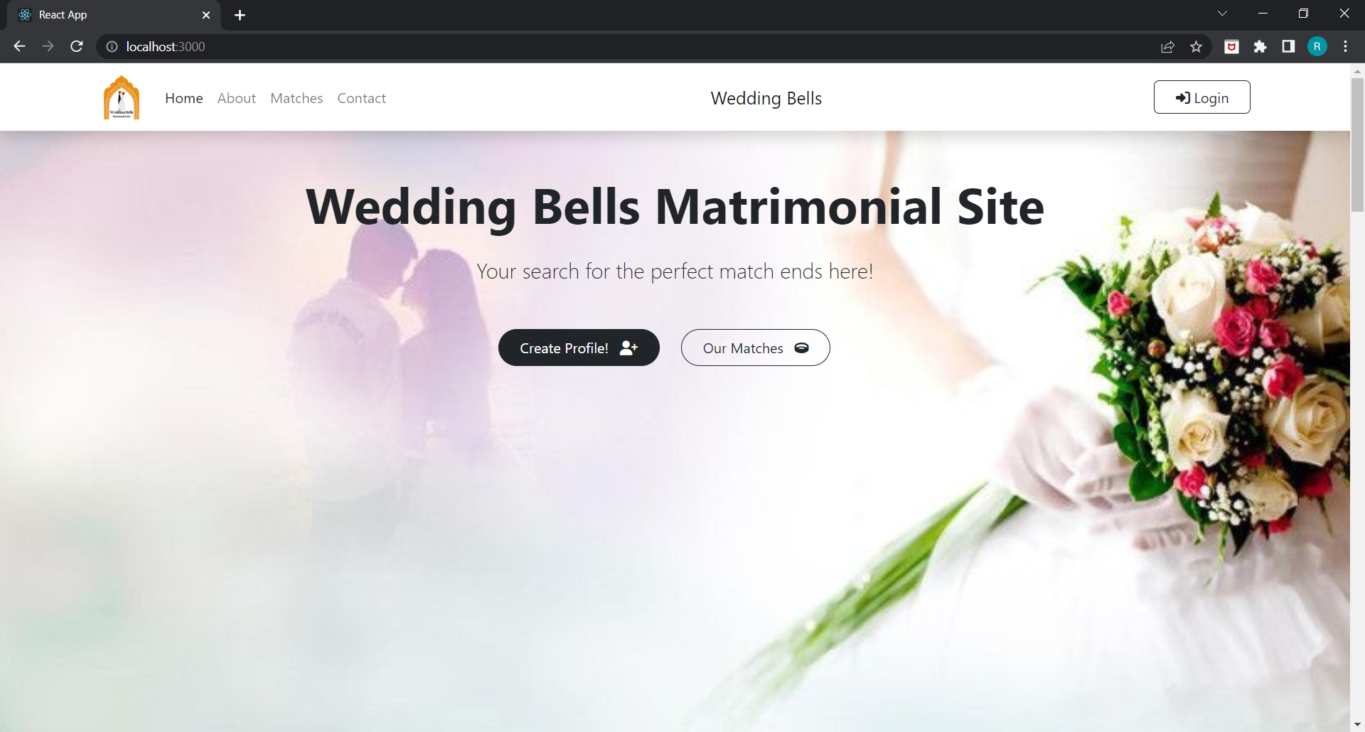
Images of project – Home Page

Slide 5
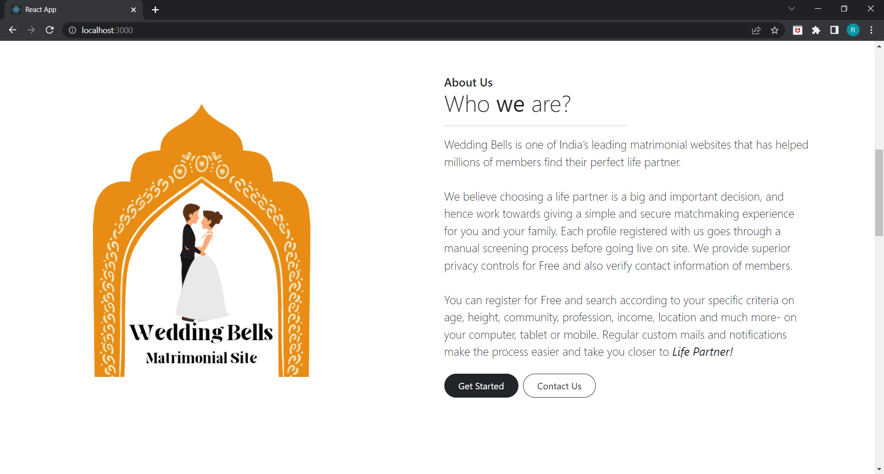
About page

Slide 6
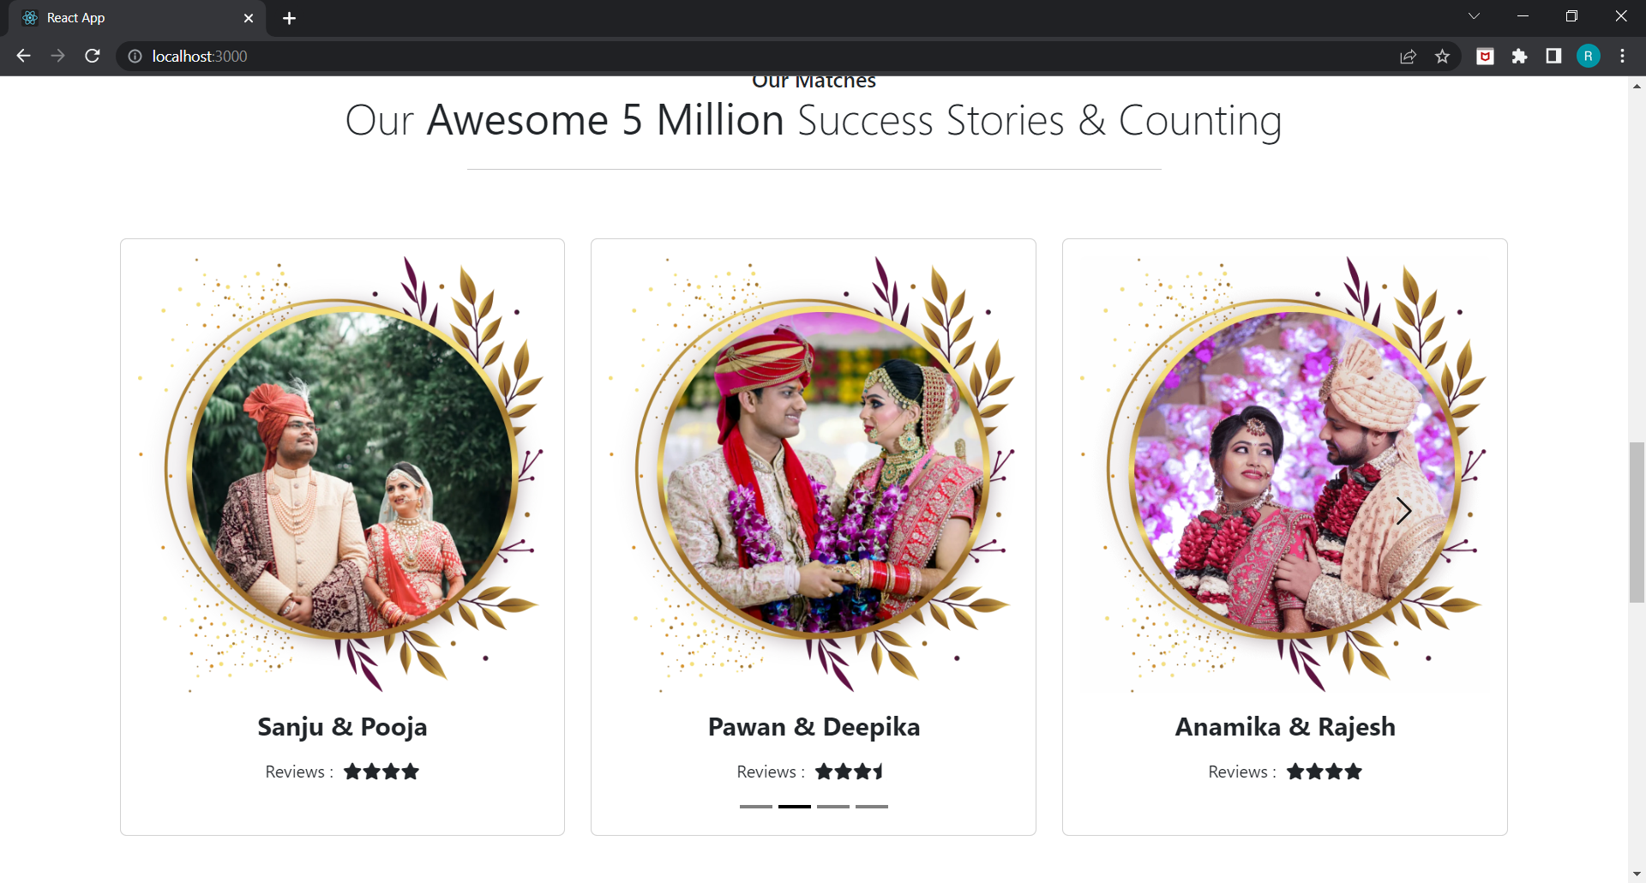
Our matches

Slide 7
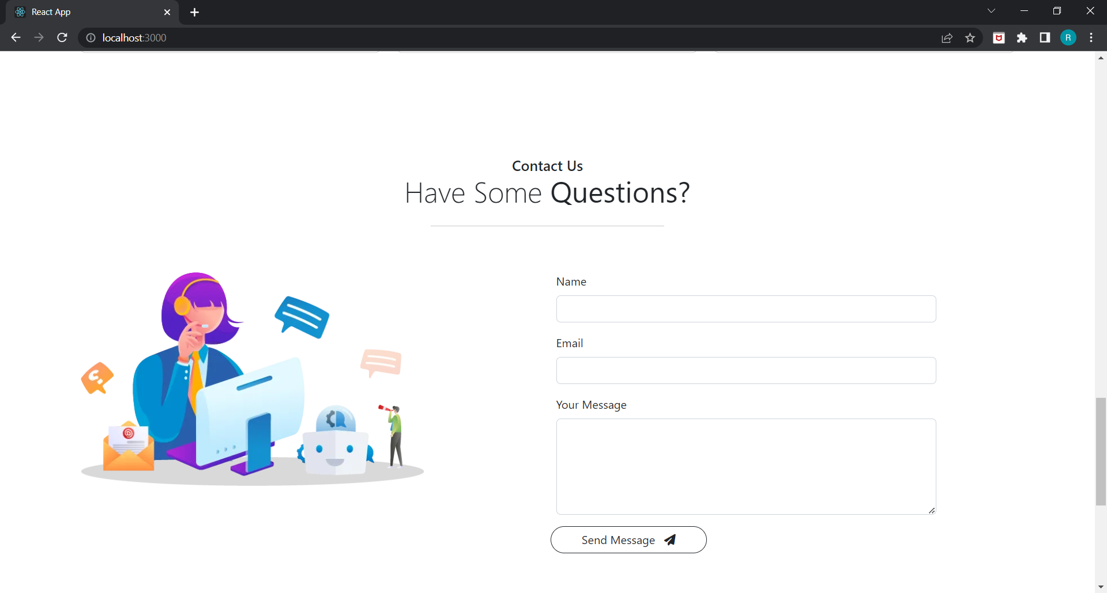
Contact Page

Slide 8
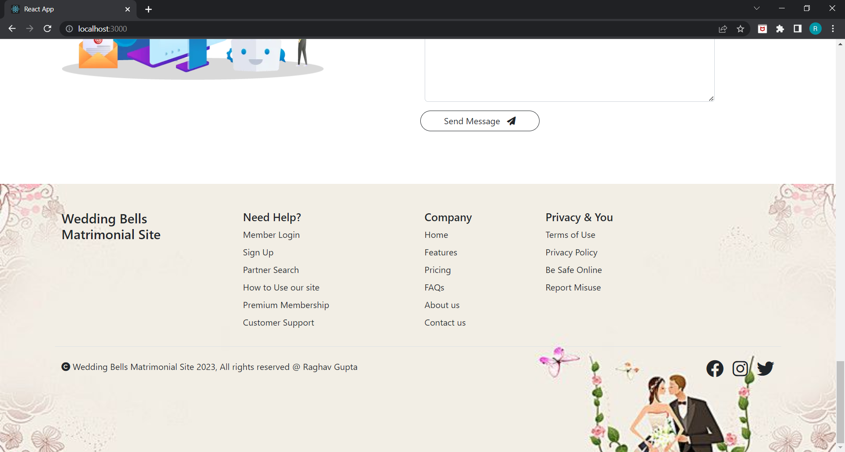
Footer Page

Slide 9
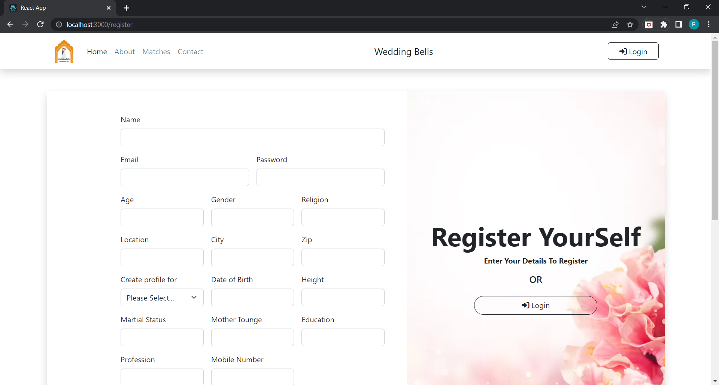
Register Page

Slide 10
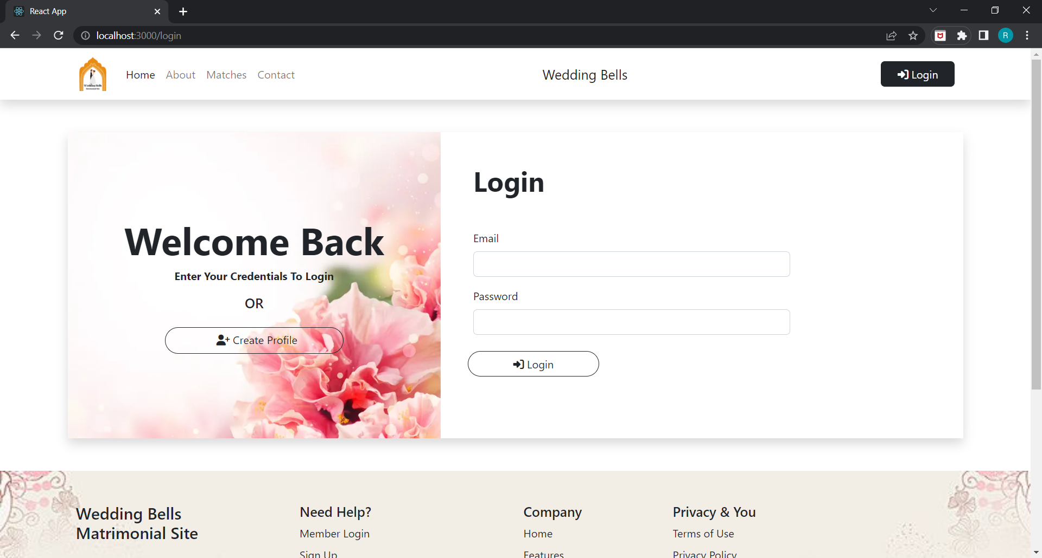
Login Page

Slide 11
Thank You

